Slide 1
Introduction to statistical software (EPIB 613)
Course walkthrough
Fall 2018
Instructor: Yi Lian

Slide 2
Course logistics
Location: EDUC 437
Time: Thursdays, 11:35am-12:55pm
Credits: 1
Exams: none
Assignments: 3
Contact: yi.lian@mail.mcgill.ca
Office hours: after class or by appointment

Slide 3
Course objectives
Introduce you to statistical software (R)
Guide you through basic data management and analysis
Provide hands-on experience
Prepare you for EPIB 603…

Slide 4
Course requirements & evaluation
Pass/fail course
In order to pass:
Attend
Participate*
Do your homework
*Participate = bring a laptop (or befriend someone who has
one), load the software, follow along with the lectures

Slide 5
Assignments
Due at 5pm on the day of the deadline
Submit via myCourses
Late assignments penalized 10% per day
Completed assignments must be in PDF
Written responses must be your own
Plagiarism rules strictly enforced

Slide 6
Date | Class | Assignments
6 Sep 2018 | Lecture 1: Introduction
13 Sep 2018 | Lecture 2: An Overview of R-Part I
20 Sep 2018 | Lecture 3: An Overview of R-Part II
27 Sep 2018 | Lecture 4: Data Management-Part I
4 Oct 2018 | Lecture 5: Data Management-Part II | HW 1 assigned
11 Oct 2018 | Lecture 6: Graphics with R | HW 1 due
18 Oct 2018 | Lecture 7: Descriptive statistics with R (quantitative)
25 Oct 2018 | Lecture 8: Descriptive statistics with R (categorical)
1 Nov 2018 | Lecture 9: Basic statistical tests with R
7 Nov 2018 | Lecture 10: Regression with R (linear) | HW 2 assigned
15 Nov 2018 | Lecture 11: Regression with R (logistic/Poisson) | HW 2 Due
22 Nov 2018 | Lecture 12: Regression with R (survival) | HW 3 assigned
29 Nov 2018 | Lecture 13: Overview of advanced topics | HW 3 Due

Slide 7
A few notes
This is a “standardized course”
These course notes constitute a user guide
The advanced concepts will become clear as you move through the MSc/PhD program (I promise)
Take advantage! And also:
Be patient (with yourself, with R, with me)
Don’t panic
Understand the importance and utility of every analyst’s secret to success:

Slide 8
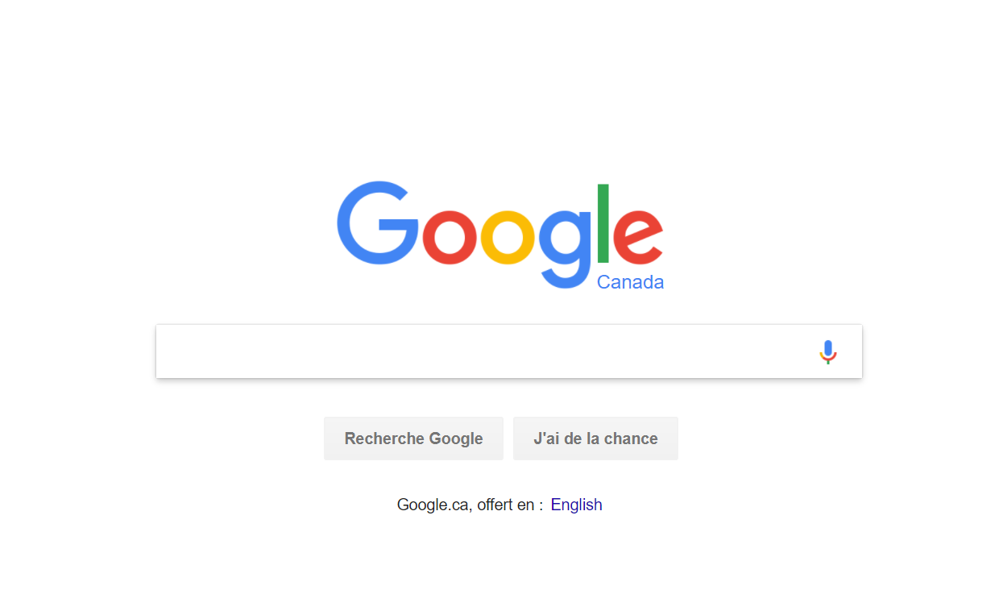

Slide 9
Software options
Popular software packages for quantitative analysis:
R
Stata
SAS
SPSS
Many more…
Your supervisor might ask you to learn a second program (this is a good thing)

Slide 10
Good practice
Regardless of your software package, always
Save and annotate your analytical code
Ask yourself if a stranger could walk in and easily reproduce your findings
More importantly, make sure you can reproduce your findings…even if you’re revisiting an analysis much later (this happens a lot)
Key word = replicability

